Slide 1


Traveler Smart Connected device
Nikola Janjusevic, DongKyu Kim,
Varouzan Knouni, Justin Jose

Slide 2
CUSTOMER SEGMENT

Slide 3

18 – 30 years old solo Backpackers who travel frequently

Slide 4
Value Proposition

Slide 5
- A Bluetooth or NFC enabled device that connects to a smartphone to track/locate multiple items simultaneously

Slide 6
Competition

Slide 7
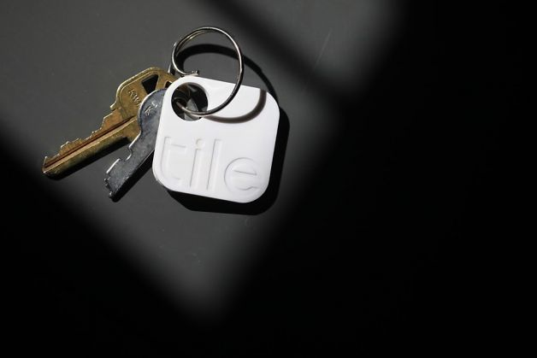
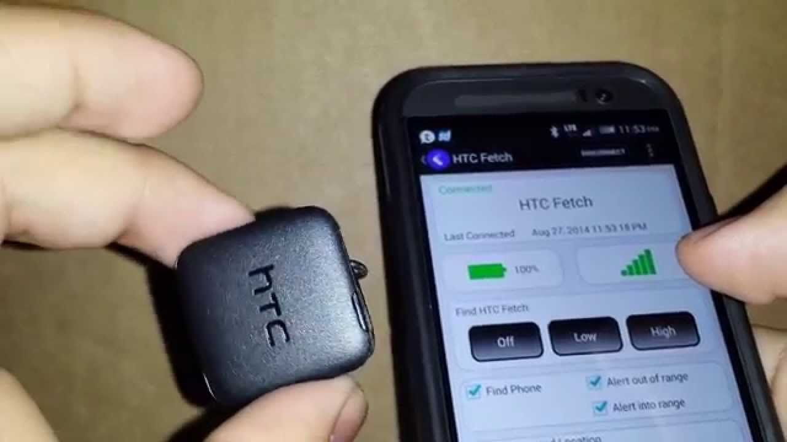
TILE
HTC
Fetch

Slide 8
What we learned from Interviews

Slide 10
Only 1 in 12 travelers interviewed were concerned about losing stuff

Slide 11
SO WHAT NOW?

Slide 12
We learned that we must change the value prop

Slide 13
Lessons from InTERVEWS ROUND 2

Slide 14
The majority of backpackers interviewed (7 out of 8) encountered back and shoulder pain when traveling

Slide 15
PROBLEMS WITH THIS:
Cost of massage parlor
Dislike of being touched by others
Distance from massage parlor

Slide 16
Our Solution

Slide 17
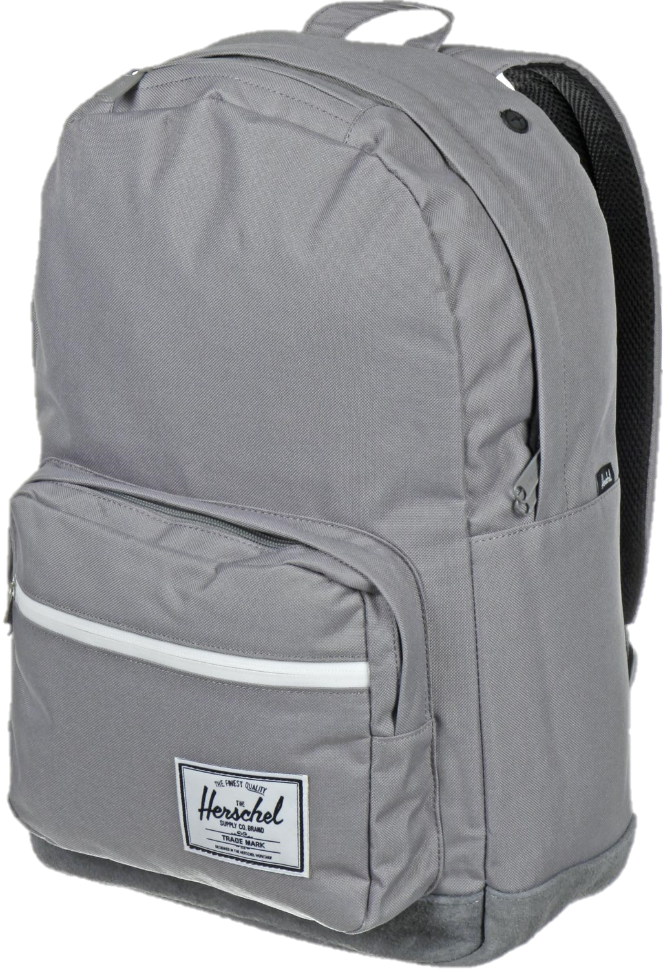
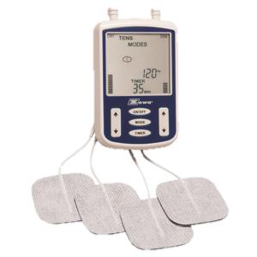
BACKPACK
+
TENS UNIT

